Slide 1

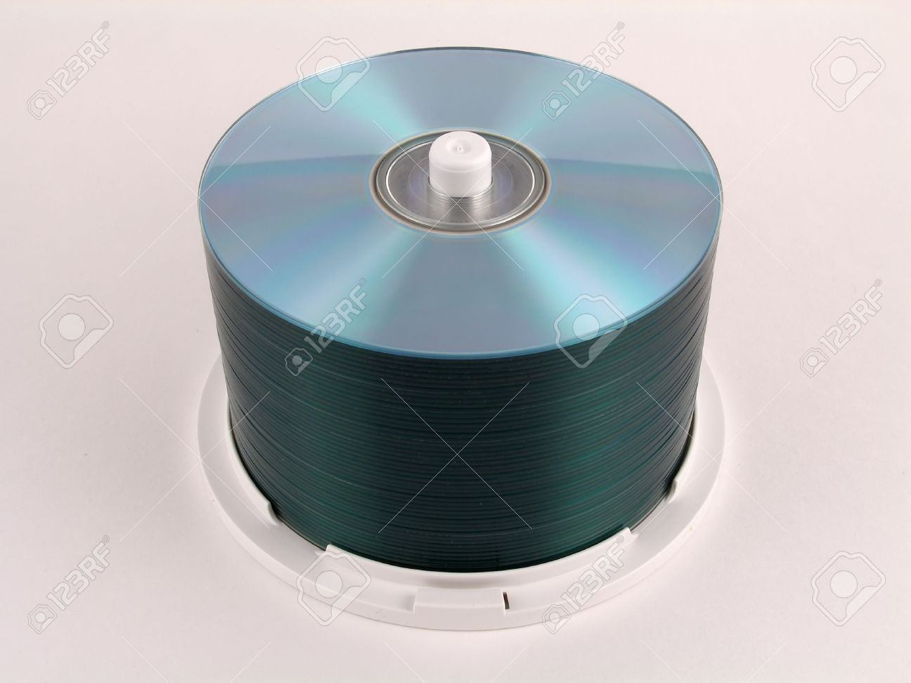
Stack

Slide 2
Stack Overview
Stack ADT
Basic operations of stack
Pushing, popping etc.
Implementations of stacks using
array
linked list

Slide 3
What is a Stack?
A stack is a list ADT with the restriction that insertions and deletions can be performed in only one position, namely, the end of the list, called the top.
The operations: push (insert) and pop (delete)
pop
push(o)
3
2
7
6
Top

Slide 4
The Stack ADT
Fundamental operations:
Push: Equivalent to an insert
Pop: Deletes the most recently inserted element
Top: Examines the most recently inserted element

Slide 5
Stack ADT
Stacks are less flexible
but are more efficient and easy to implement
Stacks are known as LIFO (Last In, First Out) lists.
– The last element inserted will be the first to be retrieved

Slide 6
Push and Pop
Primary operations: Push and Pop
Push
Add an element to the top of the stack
Pop
Remove the element at the top of the stack
empty stack push an element push another
pop
top
B
top
top
top
A
A
A

Slide 7
Implementation of Stacks
Any list implementation could be used to implement a stack
Arrays (static: the size of stack is given initially)
Linked lists (dynamic: never become full)
We will explore implementations based on array and linked list
Let’s see how to use an array to implement a stack first

Slide 8
Array Implementation
Need to declare an array size ahead of time
Associated with each stack is TopOfStack
– for an empty stack, set TopOfStack to -1
Push
– (1)
– (2)
Increment TopOfStack by 1. Set Stack[TopOfStack] = X
Pop
– (1)
– (2)
Set return value to Stack[TopOfStack] Decrement TopOfStack by 1
These operations are performed in very fast constant time

Slide 9
Implementation by Array
use Array with a top index pointer as an implementation of stack
arr
0
1
2
3
4
5
6
7 8
9
A A B C
D
top

Slide 10
Implementation by Array
use Array with a top index pointer as an implementation of stack
Push(E)
arr
0
1
2
3
4
5
6
7 8
9
A A B C
D
E
top

Slide 11
Implementation by Array
use Array with a top index pointer as an implementation of stack
Push(F)
arr
0
1
2
3
4
5
6
7 8
9
A A B C
D
E
F
top

Slide 12
Implementation by Array
use Array with a top index pointer as an implementation of stack
Pop()
arr
0
1
2
3
4
5
6
7 8
9
A A B C
D
E
F
top

Slide 13
/* Program of stack using array*/
#include<stdio.h>
#define MAX 5
int top = -1;
int stack_arr[MAX];
main()
{
int choice;
while(1)
{
printf("1.Push\n");
printf("2.Pop\n");
printf("3.Display\n");
printf("4.Quit\n");
printf("Enter your choice : ");
scanf("%d",&choice);
switch(choice)
{
case 1 :
push();
break;
case 2:
pop();
break;

Slide 14
case 3:
display();
break;
case 4:
exit(1);
default:
printf("Wrong choice\n");
}/*End of switch*/
}/*End of while*/
}/*End of main()*/
push()
{
int pushed_item;
if(top == (MAX-1))
printf("Stack Overflow\n");
else
{
printf("Enter the item to be pushed in stack : ");
scanf("%d",&pushed_item);
top=top+1;
stack_arr[top] = pushed_item;
}
}/*End of push()*/

Slide 15
pop()
{
if(top == -1)
printf("Stack Underflow\n");
else
{
printf("Popped element is : %d\n",stack_arr[top]);
top=top-1;
}
}/*End of pop()*/
display()
{
int i;
if(top == -1)
printf("Stack is empty\n");
else
{
printf("Stack elements :\n");
for(i = top; i >=0; i--)
printf("%d\n", stack_arr[i] );
}
}/*End of display()*/

Slide 16
Implementation based on Linked List
Now let us implement a stack based on a linked list
Top of Stack = Front of Linked-List
head
a₁
a₂
a₃
a₄

Slide 17
/* Program of stack using linked list*/
# include<stdio.h>
# include<malloc.h>
struct node
{
int info;
struct node *link;
} *top=NULL;
main()
{
int choice;
while(1)
{ printf("1.Push\n");
printf("2.Pop\n");
printf("3.Display\n");
printf("4.Quit\n");
printf("Enter your choice : ") ;
scanf("%d", &choice);
switch(choice)
{
case 1:
push();
break;

Slide 18
case 2:
pop();
break;
case 3:
display();
break;
case 4:
exit(1);
default :
printf("Wrong choice\n");
}/*End of switch */
}/*End of while */
}/*End of main() */
push()
{
struct node *tmp;
int pushed_item;
tmp = (struct node *)malloc(sizeof(struct node));
printf("Input the new value to be pushed on the stack : ");
scanf("%d",&pushed_item);
tmp->info=pushed_item;
tmp->link=top;
top=tmp;
}/*End of push()*/

Slide 19
pop()
{
struct node *tmp;
if(top == NULL)
printf("Stack is empty\n");
else
{ tmp=top;
printf("Popped item is %d\n",tmp->info);
top=top->link;
free(tmp);
}
}/*End of pop()*/
display()
{ struct node *ptr;
ptr=top;
if(top==NULL)
printf("Stack is empty\n");
else
{
printf("Stack elements :\n");
while(ptr!= NULL)
{
printf("%d\n",ptr->info);
ptr = ptr->link;
}/*End of while */
}/*End of else*/
}/*End of display()*/

Slide 20
Applications
Many application areas use stacks:
line editing
bracket matching
postfix calculation
function call stack

